Slide 1

Proposed Bookend “Connections” Course
Marymegan Daly.66 Associate Dean of Undergraduate Education
Melissa Beers.3 Senior Director of the Bookends Program
Sarah Holt.249 Senior Instructional Designer
Allison Schultz.875 Instructional Designer
Ben Kenzer.1 Instructional Designer

Slide 2
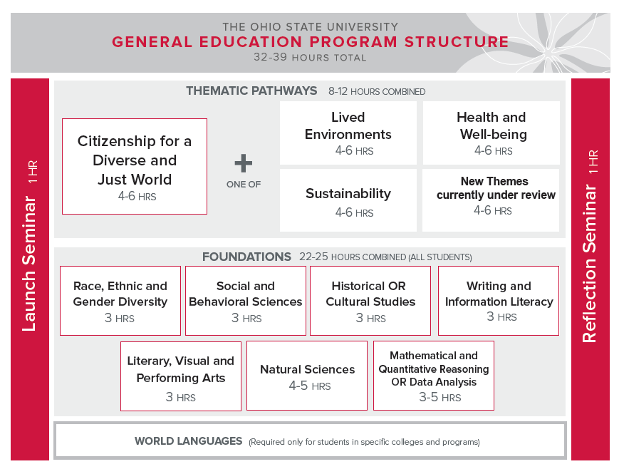


Slide 3
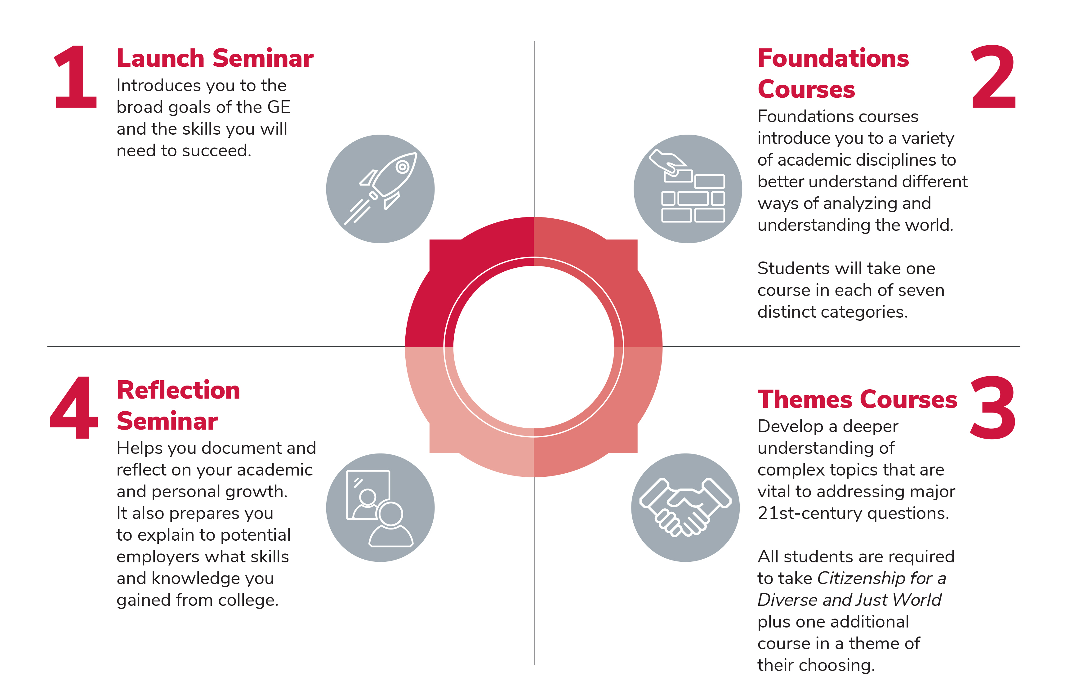
The GE Pathway

Slide 4
Metacognition and Academic Skills
Launch Goal 1: Develop an understanding of the purpose and structure of the GE
Launch Goal 2: Begin to develop critical skills and habits to navigate the academic environment
Reflection Goal 1: Demonstrate the intellectual and cognitive skills that prepare them to be engaged citizens and leaders for life by reflecting on a range of important modes of human thought, inquiry and expression

Slide 5
Self-awareness and Identity Development
Launch Goal 3: Articulate academic and program goals and find opportunities to express those goals within the GE from various disciplinary perspectives
Reflection Goal 2: Engage with significant aspects of the human condition in local, state, national and global settings
Reflection Goal 3: Demonstrate skills and abilities needed for engaged citizenship and personal and professional growth

Slide 6
Goals in developing structure & content of Bookends
Support skill development
Address cross-cutting skills and foundational issues like (academic) identity, integrity
Highlight need for interdisciplinarity and intercultural competence
Opportunity for student-focused, expert led courses that promote academic engagement and belonging

Slide 7
LAUNCH
Bookend course
One-credit opening seminar
Introduces:
  Broad goals of the GE
  Key skills needed to succeed
Development of habits to best navigate the academic environment
Notes:
Missy, these are placeholders for your content about what the existing bookends courses are/do

Slide 8

Launch introduces students to ePortfolios
Notes:
Missy, these are placeholders for your content about what the existing bookends courses are/do

Slide 9
REFLECTION
Bookend course
One-credit capstone seminar
Document and reflect on academic and personal growth
Prepare to explain to potential employers the skills and knowledge gained at Ohio State
Notes:
Missy, these are placeholders for your content about what the existing bookends courses are/do

Slide 10

What is the Connections Seminar?
“Bookend” that addresses different academic experiences, timelines, and needs of transfer students

Slide 11
Goals in developing structure & content of Bookends
Support skill development
Address cross-cutting skills and foundational issues like (academic) identity, integrity
Highlight need for interdisciplinarity and intercultural competence
Opportunity for student-focused, expert led courses that promote academic engagement and belonging
Notes:
Do all these things, acknowledging and leveraging as a strength the diverse pre-OSU experiences of the students. Help them understand those experiences within their OSU context. Ensure that they have a strong point of connection between their previous work and their goals.

Slide 12
Notes:
This is in their packet. Note the course is developed to be synchronous, in-person or online

Slide 14
By the end of this course, students should successfully be able to:
 | LAUNCH |  | CONNECTION |  | REFLECTION
 | Describe the integrative nature of the structural elements of the GE. |  | Reflect on their developing academic motivation as well as emerging professional or disciplinary identities. |  | Reflect on their developing academic motivation as well as emerging professional or disciplinary identities.
 | Demonstrate comprehension of the purpose of the GE. |  | Critically evaluate their experiences as engaged citizens and leaders with significant questions spanning a range of important modes of human thought, inquiry, and expression. |  | Critically evaluate their experiences as engaged citizens and leaders with significant questions spanning a range of important modes of human thought, inquiry, and expression.
 | Demonstrate basic familiarity with the ePortfolio system. |  | Describe the integrative nature of the structural elements of the GE and purpose of the GE at Ohio State. |  | Reflect on personal development in the areas of curiosity, imagination, adaptability, and intentionality to achieve personal and professional goals.
 | Use technology effectively to accomplish academic and personal goals. |  | Demonstrate basic familiarity with the ePortfolio system. |  | Critically evaluate skills needed to maintain personal well-being and resiliency.
 | Critically consider implications of information and technology use. |  | Use technology effectively to accomplish academic and personal goals. |  | Reflect on their developing intercultural competency.
 | Articulate one's academic identity, motivations, and curiosity. |  | Reflect on personal development in the areas of curiosity, imagination, adaptability, and intentionality to achieve personal and professional goals. |  | Critically evaluate one's understanding and awareness of the global context and recognize opportunities to contribute to and shape the larger world.
 | Develop a plan to investigate a personal, societal, or global question within the GE from various disciplinary perspectives. |  | Critically evaluate the skills needed to maintain personal wellbeing and resiliency.
 |  |  | Reflect on their developing intercultural competency.
 |  |  | Critically evaluate one’s understanding and awareness of the global context, and to recognize opportunities to contribute to and shape the larger world.
Notes:
The ELOs of Connections blend those of Launch and Reflection

Slide 15
Notes:
Transition to Express for assignment demo

Slide 17
Notes:
Blue: Intellectual and cognitive skills that prepare them to be engaged citizens by reflecting on range of modes of thought, inquiry, expression
Yellow: Be interculturally competent Global Citizens who can engage with communities on significant aspects of the human experience
Gray: Skills and abilities needed for engaged citizenship and personal/professional growth

Slide 18
Questions?

